Slide 1


Year 2020-21
Digital Communication
E-Laboratory and practicals
B.Tech. II (CSE), semester –III
By
Prof. Naresh B. Kanirkar
Prof. Mehul C. Patel Assisted by
Arpan Shah
Department of Electronics Engineering
Sardar Vallabhbhai National Institute of Technology, Ichchhanath, Surat-395 007, Gujarat

Slide 2
Experiment-10
Objective- To study of pulse code modulation (PCM) and demodulation technique.

Slide 3
Pulse Code Modulation (PCM)
PCM is a technique, which is used to convert an analog signal into digital signal.
PCM is a preferred method of communication within the public switched telephone network (PSTN)
A PCM stream is determined by two following steps:
Sampling rate- which is the number of times per second that samples are taken.
Bit depth- which determines the number of possible digital values that can be used to represent each sample.
Hence, the output of a PCM resembles a binary sequence.

Slide 4
Why digital transmission??
Less susceptible to interference cause by noise due to discrete level.
Easy to detect errors due to discrete level.
Easy to encrypt(Higher security)
Simpler to store digital data

Slide 5
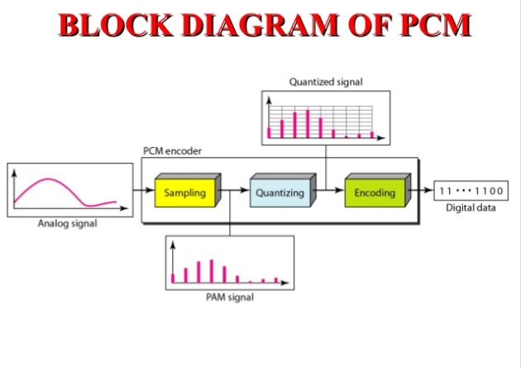

Slide 6
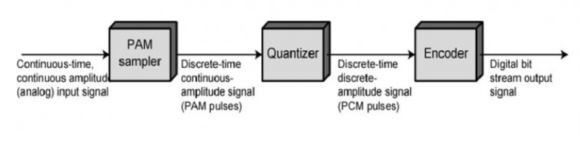
Block diagram of PCM

Slide 7
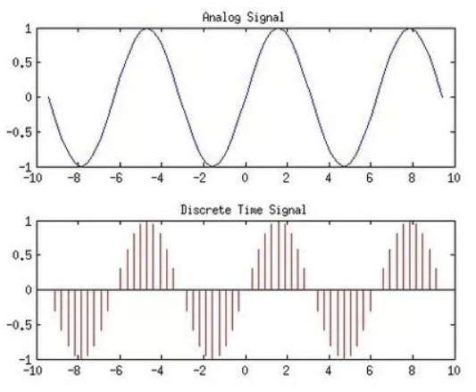
Sampling
Sampler extract samples of a continuous signal.
Sampler produces samples that are equivalent to the instantaneous value of the continuous signal at the specified various points.
The Sampling process generates flat- top Pulse Amplitude Modulated (PAM) signal.

Slide 8
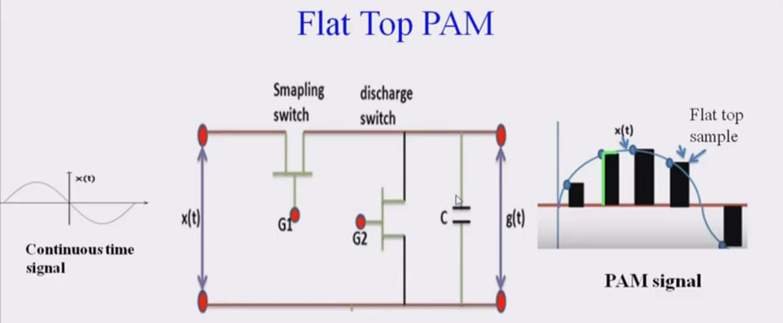

Slide 9
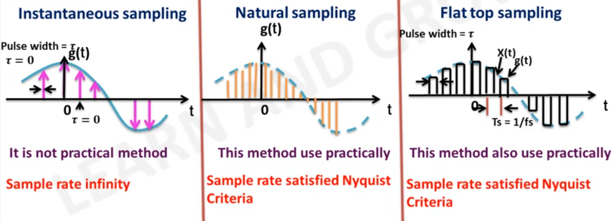

Slide 10
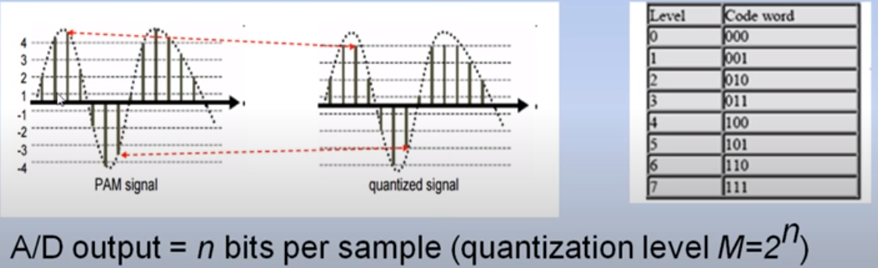
Quantization
Quantization is done by dividing the range of possible values of the analog samples into some different levels and assigning the center value of each level to any sample in the quantization interval.
Quantization approximates the analog sample values with the nearest quantization values.

Slide 11
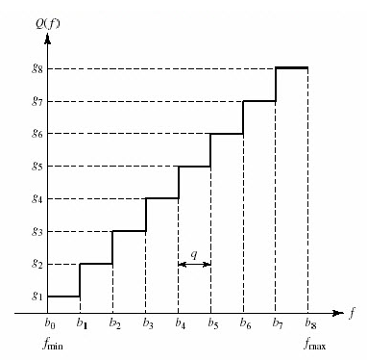
Uniformly Quantized Signal

Slide 12
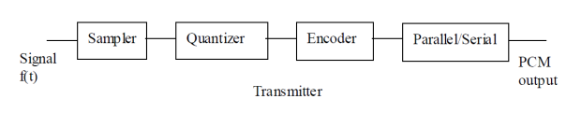
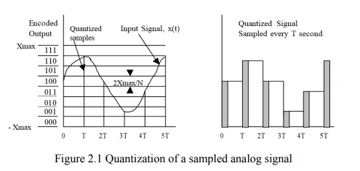
Pulse Code Modulation (PCM) is a method of converting an analog signal into a digital signal (A/D conversion).

Slide 13
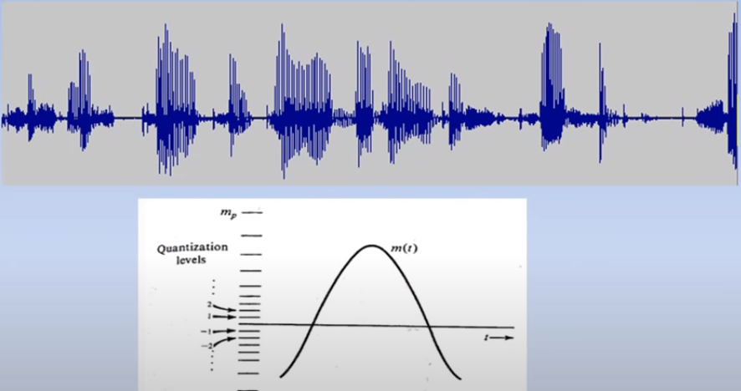

Slide 14
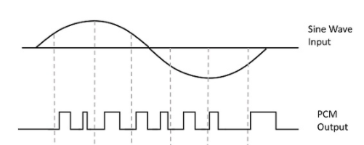
PCM produces a series of numbers or digits instead of a pulse train.
Each one of these digits, in binary code, represent the approximate amplitude of the signal sample at that instant.

Slide 15
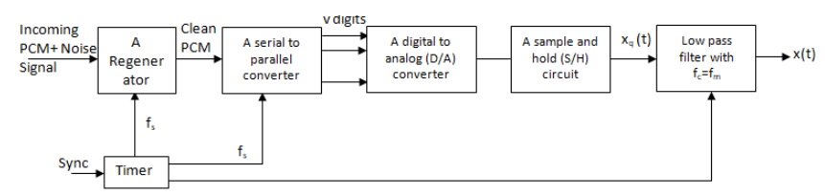
PCM Receiver

Slide 16
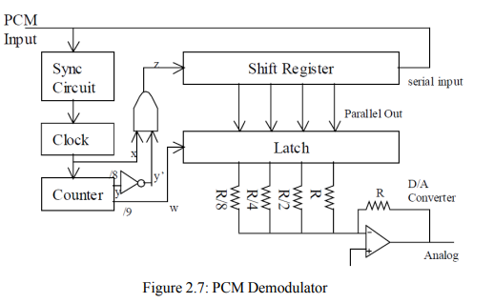

Slide 17
Conclusion
In PCM transmitter , the signal x(t) is first passed through the low-pass filter of cut-off frequency f_{m} Hz .
This low-pass filter blocks all the frequency components above f_{m} Hz. This means that now the signal x(t) is band-limited to f_{m} Hz .
The sample and hold circuit then samples this signal at the rate of f_{s}.
Sampling frequency f_{s} is selected sufficiently above Nyquist rate to avoid aliasing
The output from sample and hold circuit is denoted by x(nT_{s}).
This signal x(nT_{s}) is discrete in time and continuous in amplitude.
A q-level quantizer compares input x(nT_{s}) with its fixed digital levels.
Quantized signal is then encoded in PCM output using encoder.

Slide 18
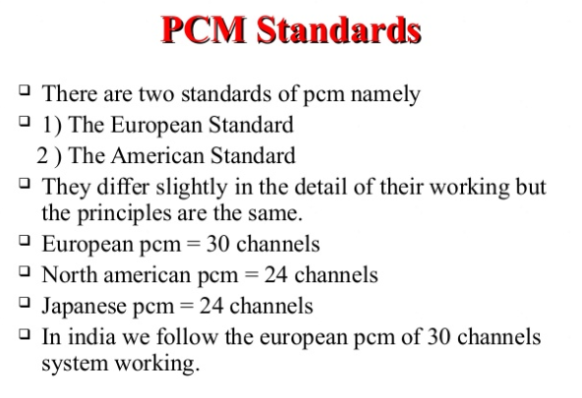

Slide 19
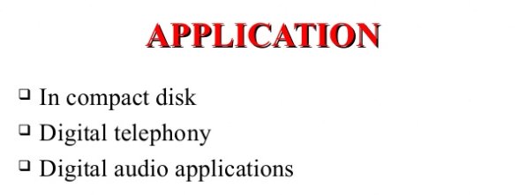

Slide 20
MATLAB

Slide 21
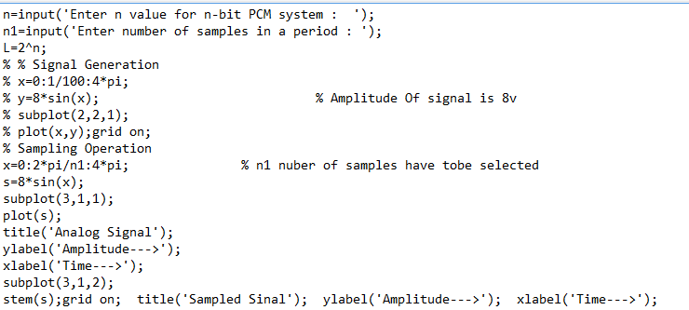
1. Sampling

Slide 22
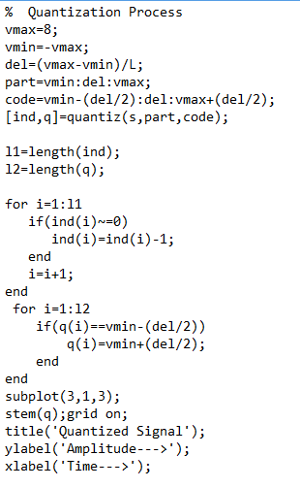
2. Quantization
% level are between vmin and vmax with difference of del
% Contain Quantized values
% Quantization process
% To make index as binary decimal so started from 0 to N
% To make quantize value in between the levels
% Display the Quantize values

Slide 23
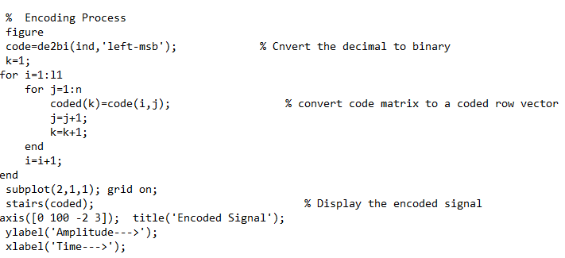
3. Encoding

Slide 24
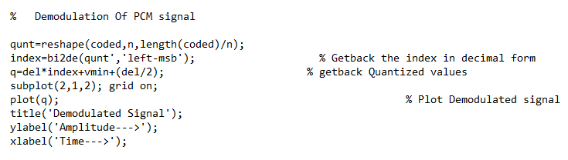
4. Demodulation

Slide 25
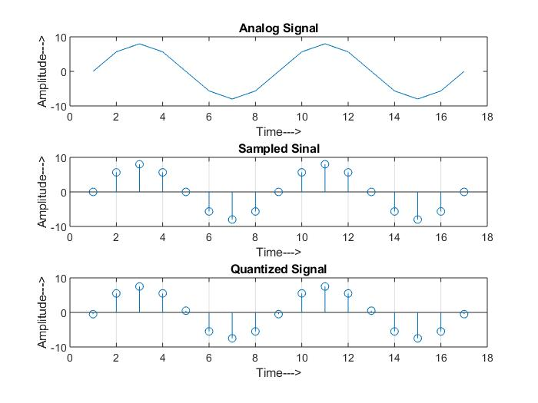

Slide 26
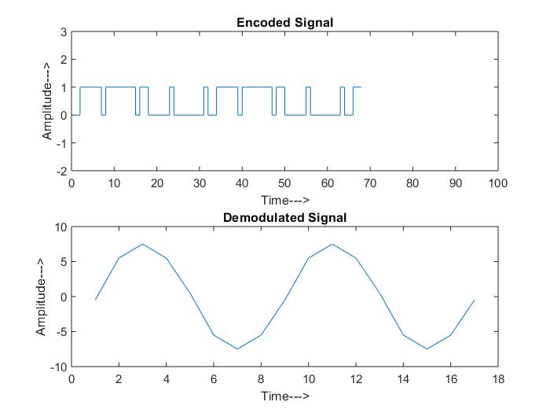

Slide 27



